Slide 1
Chapter 3 Growth of Functions
Chi-Yeh Chen
陳奇業
成功大學資訊工程學系

Slide 2



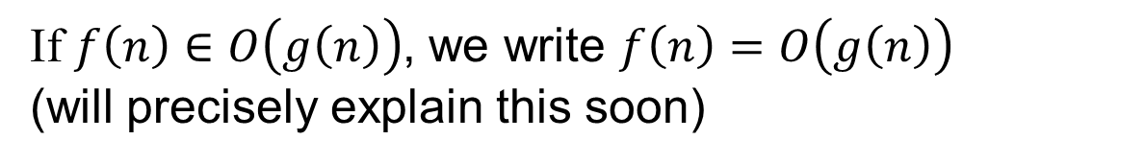

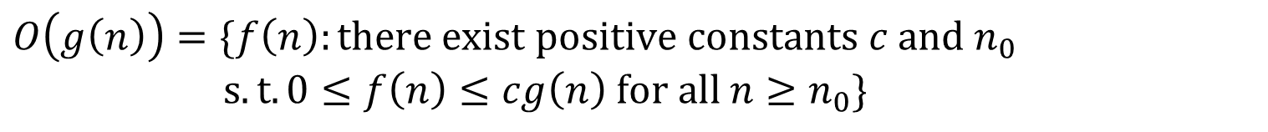
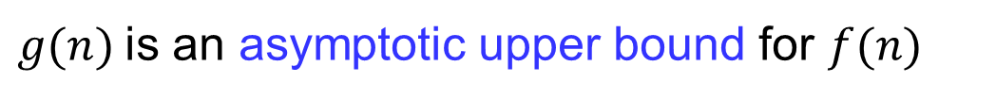
Asymptotic notation
$$O\left(g\left(n\right)\right)=\{f\left(n\right):there exist positive constants c and n_{0}$$ $s.t. 0≤f\left(n\right)≤cg\left(n\right) for all n≥n_{0}\}$
$g(n)$is an asymptotic upper bound for $f(n)$
If $f\left(n\right)∈O\left(g\left(n\right)\right)$, we write $f\left(n\right)=O\left(g\left(n\right)\right)$
(will precisely explain this soon)

Slide 3

Asymptotic notation
$O$-notation
Example:$2n^{2}=O(n^{3})$, with $c=1$ and $n_{0}=2$
Examples of the functions in: $O(n^{2})$

Slide 4
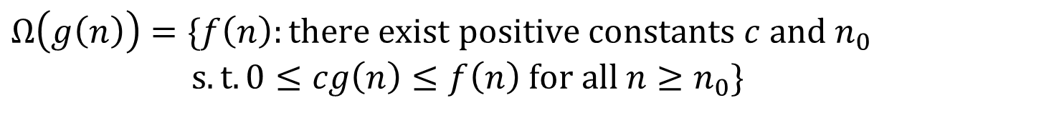
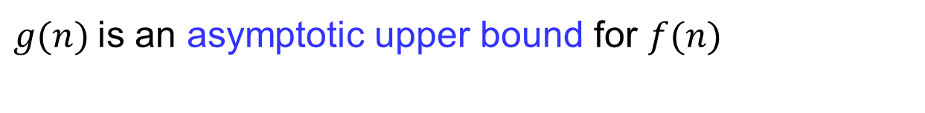
Asymptotic notation
$$Ω\left(g\left(n\right)\right)=\{f\left(n\right):there exist positive constants c and n_{0}$$ $s.t. 0≤cg\left(n\right)≤f\left(n\right) for all n≥n_{0}\}$
$g(n)$is an asymptotic upper bound for $f(n)$

Slide 5

Asymptotic notation
$Ω$-notation
Example:$\sqrt{n}=Ω(\lg{n})$, with $c=1$ and $n_{0}=16$
Examples of the functions in: $Ω(n^{2})$

Slide 6
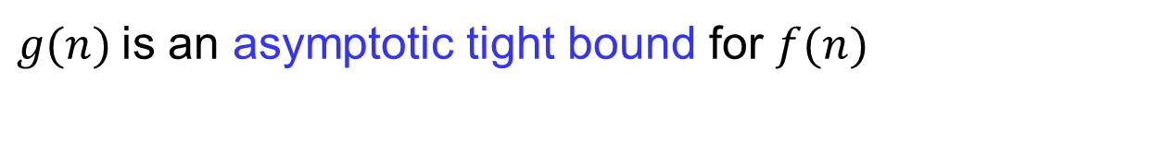
Asymptotic notation
$$Θ\left(g\left(n\right)\right)=\{f\left(n\right):there exist positive constants c_{1},c_{2} and n_{0}$$ $s.t. 0≤c_{1}g\left(n\right)≤f\left(n\right)≤c_{2}g\left(n\right) for all n≥n_{0}\}$
$g(n)$is an asymptotic tight bound for $f(n)$

Slide 7
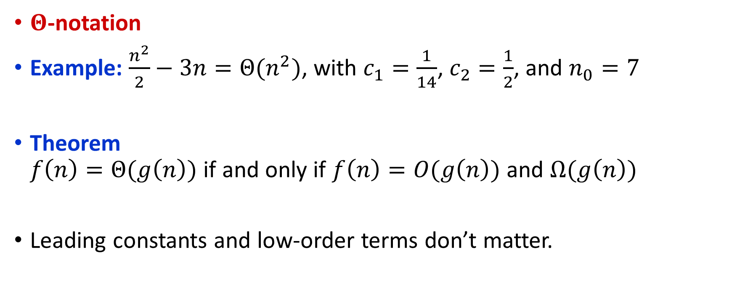
Asymptotic notation
$Θ$-notation
Example: $\frac{n^{2}}{2}−3n=Θ(n^{2})$, with $c_{1}=\frac{1}{14}$, $c_{2}=\frac{1}{2}$, and $n_{0}=7$
Theorem $f\left(n\right)=Θ(g\left(n\right))$ if and only if $f\left(n\right)=O(g\left(n\right))$ and $Ω(g\left(n\right))$
Leading constants and low-order terms don’t matter.

Slide 8

$T\left(n\right)=T\left(n−2\right)+n\log{\frac{n}{2}}$ (Assume $n$ is even.)
Proof $O$:
$T\left(n\right)=T\left(n−2\right)+n\log{\frac{n}{2}}$
$=T(n−4)+ (n−2) \log{\frac{n−2}{2}}+n\log{\frac{n}{2}}$
$=c+2\log{\frac{2}{2}}+4\log{\frac{4}{2}}+…+(n−2) \log{\frac{n−2}{2}}+n\log{\frac{n}{2}}$
$≤c+n\log{\frac{n}{2}}+n\log{\frac{n}{2}}+…+n\log{\frac{n}{2}}+n\log{\frac{n}{2}}$
$=c+\frac{n}{2}∗n\log{\frac{n}{2}}=c+\frac{n^{2}}{2}\log{\frac{n}{2}}$
$Therefore,T\left(n\right)=O(n^{2}\log{n})$

Slide 9

$T\left(n\right)=T\left(n−2\right)+n\log{\frac{n}{2}}$ (Assume $n$ is even.)
Proof $Ω$:
$T\left(n\right)=T\left(n−2\right)+n\log{\frac{n}{2}}$
$=T(n−4)+ (n−2) \log{\frac{n−2}{2}}+n\log{\frac{n}{2}}$
$=c+2\log{\frac{2}{2}}+…+(\frac{n}{2}−2)\log{\frac{(\frac{n}{2}−2)}{2}}+\frac{n}{2}\log{\frac{n}{4}}+…+n\log{\frac{n}{2}}$
$≥c+0+…+0+\frac{n}{2}\log{\frac{n}{4}}+…+n\log{\frac{n}{2}}$ (half of number)
$=c+\frac{n}{4}∗\frac{n}{2}\log{\frac{n}{4}}=c+\frac{n^{2}}{8}\log{\frac{n}{4}}$
$Therefore, T\left(n\right)=Ω(n^{2}\log{n})$
By (1)(2),$T\left(n\right)=θ(n^{2}\log{n})$

Slide 10
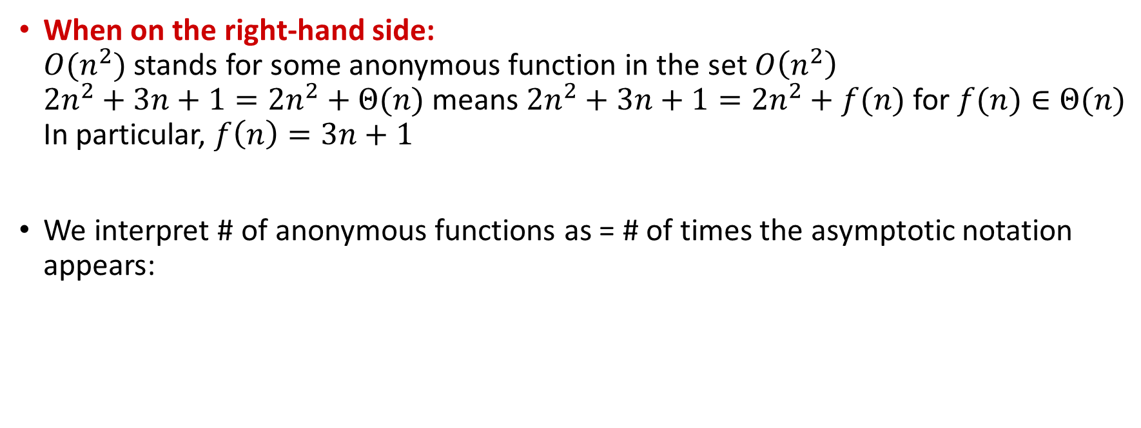
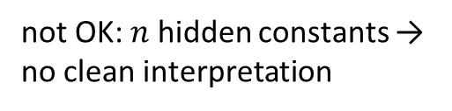
Asymptotic notation in equations
When on the right-hand side: $O(n^{2})$ stands for some anonymous function in the set $O\left(n^{2}\right)$ $2n^{2}+3n+1=2n^{2}+Θ(n)$ means $2n^{2}+3n+1=2n^{2}+f(n)$ for $f(n)∈$ $Θ(n)$ In particular, $f\left(n\right)=3n+1$
We interpret # of anonymous functions as = # of times the asymptotic notation appears:
OK: 1 anonymous function
not OK: $n$ hidden constants → no clean interpretation

Slide 11
Asymptotic notation in equations
When on the left-hand side:
No matter how the anonymous functions are chosen on the left-hand side, there is a way to choose the anonymous functions on the right-hand side to make the equation valid.

Slide 12
Asymptotic notation in equations
Interpretation

Slide 13

Asymptotic notation in equations
$o$-notation

Slide 14

Asymptotic notation in equations
$ω$ -notation

Slide 15
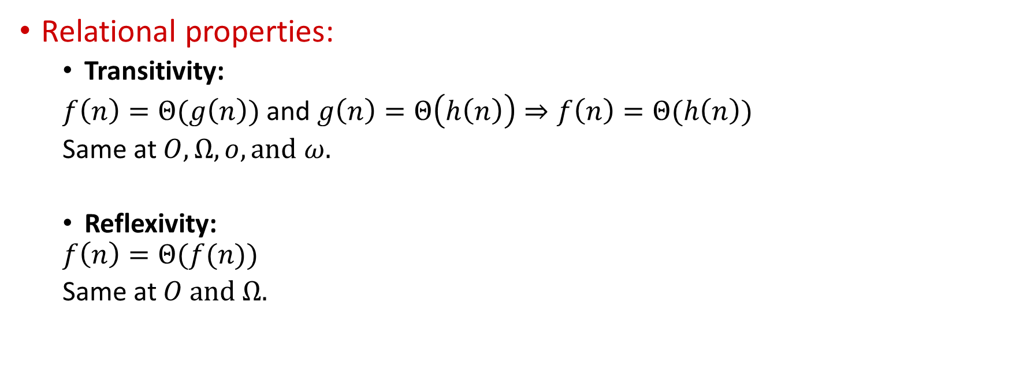
Comparisons of functions
Relational properties:
Transitivity:
$f\left(n\right)=Θ(g\left(n\right))$ and $g\left(n\right)=Θ\left(h\left(n\right)\right)⇒f\left(n\right)=Θ(h\left(n\right))$
Same at $O,Ω,o, and ω.$
Reflexivity:
$$f\left(n\right)=Θ(f(n))$$
Same at $O and Ω.$

Slide 16
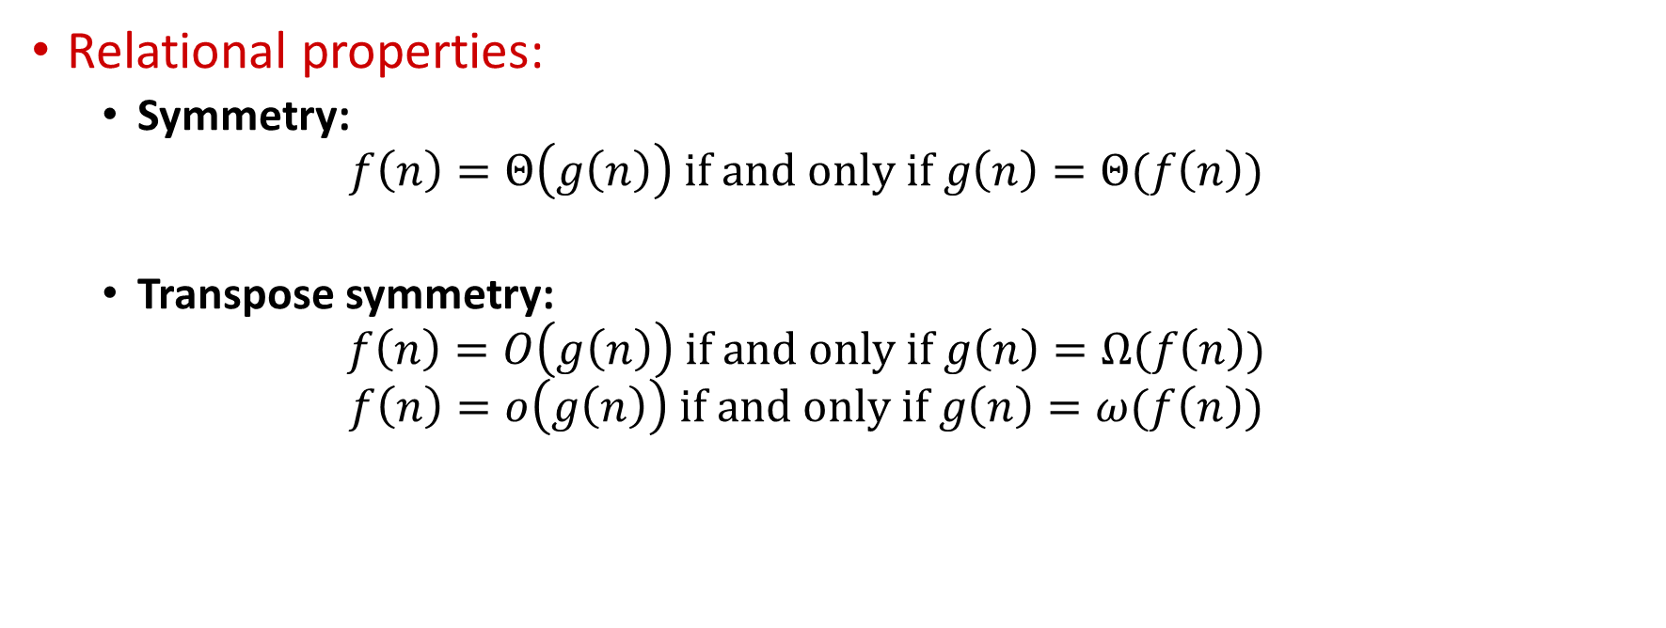
Comparisons of functions
Relational properties:
Symmetry:
$$f\left(n\right)=Θ\left(g\left(n\right)\right) if and only if g\left(n\right)=Θ(f\left(n\right))$$
Transpose symmetry:
$$f\left(n\right)=O\left(g\left(n\right)\right) if and only if g\left(n\right)=Ω(f\left(n\right))$$
$$f\left(n\right)=o\left(g\left(n\right)\right) if and only if g\left(n\right)=ω(f\left(n\right))$$

Slide 17

Comparisons:
$f(n)$ is asymptotically smaller than $g(n)$if $f(n)=o(g(n))$
$f(n)$is asymptotically larger than $g(n)$if $f(n)=ω(g(n))$

Slide 18
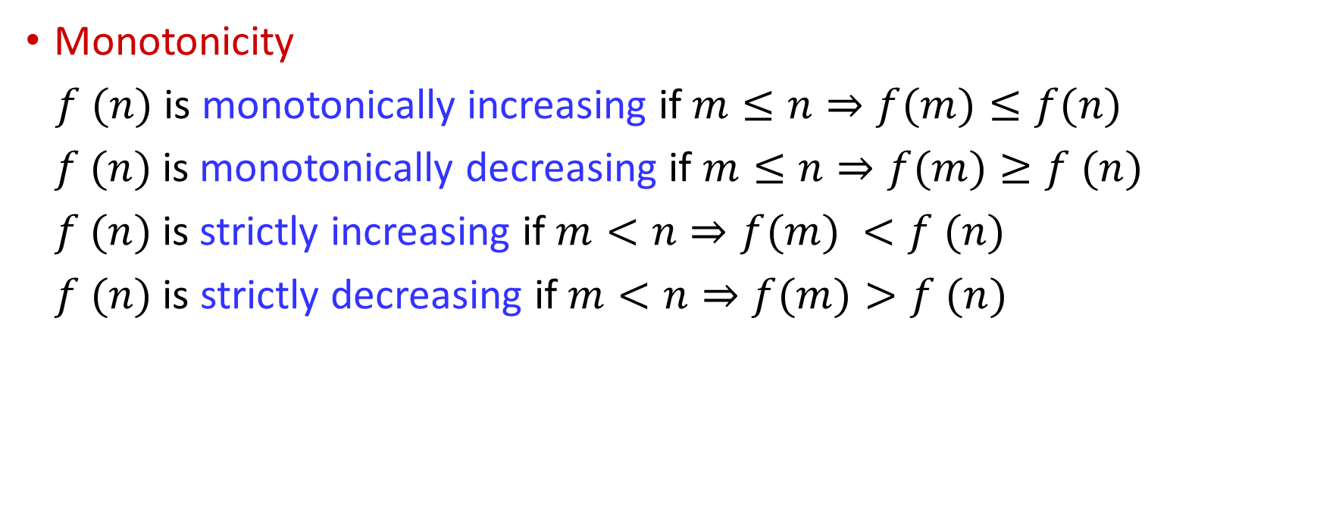
Standard notations and common functions
Monotonicity
$f (n)$ is monotonically increasing if $m≤n⇒f(m)≤f(n)$
$f (n)$is monotonically decreasing if $m≤n⇒f(m)≥f (n)$
$f (n)$is strictly increasing if $m<n⇒f(m) <f (n)$
$f (n)$is strictly decreasing if $m<n⇒f(m)>f (n)$

Slide 19
Exponentials

Slide 20
Logarithms(1)

Slide 21
Logarithms(2)

Slide 22
Logarithms(3)

Slide 23
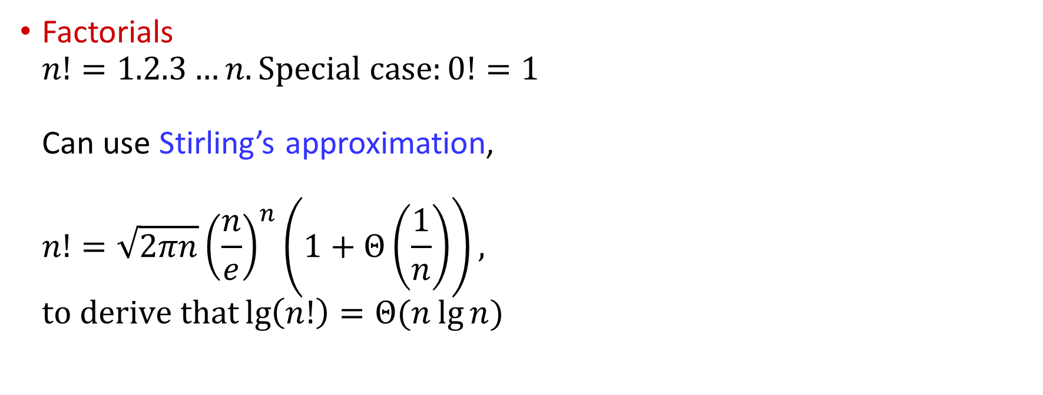
Factorials $n!=1.2.3…n. Special case:0!=1$ Can use Stirling’s approximation, $n!=\sqrt{2πn}{\left(\frac{n}{e}\right)}^{n}\left(1+Θ\left(\frac{1}{n}\right)\right),$ $to derive that\lg\left(n!\right)=Θ(n\lg{n)}$

Slide 24

Functional iteration
$f^{\left(i\right)}\left(n\right):f(n)$ iteratively applied$i$times to an initial value of $n$. $f^{\left(i\right)}\left(n\right)=\left\{\begin{aligned}n if i=0 \\ f\left(f^{\left(i−1\right)}\left(n\right)\right)if i>0\end{aligned}\right.$
ex. If $f\left(n\right)=2n$, then $f^{\left(i\right)}\left(n\right)= 2^{i}n$.

Slide 25

The iterated logarithm function
$\lg^{∗}n=min⁡\{i≥0:\lg^{(i)}n≤1\}$
ex. $\lg^{∗}2=1$,
$\lg^{∗}4=2$,
$\lg^{∗}16=3$,
$\lg^{∗}65536=4$,
$\lg^{∗}(2^{65536})=5$.

Slide 26

Fibonacci numbers
$F_{0}=0$,
$F_{1}=1$,
$F_{i}=F_{i−1}+F_{i−2}$ for $i≥2$.
golden ratio
$$φ=\frac{1+\sqrt{5}}{2}=1.61803…$$
$$\hat{φ}=\frac{1−\sqrt{5}}{2}=−.61803…$$
$⇒F_{i}=\frac{φ^{i}−\hat{φ^{i}}}{\sqrt{5}}$

Slide 27
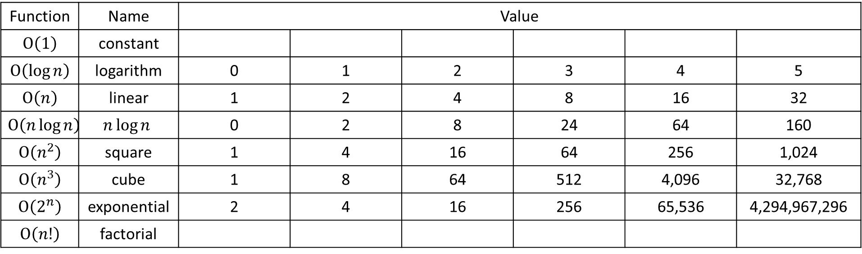
Function | Name | Value
$$O\left(1\right)$$ | constant
$$O\left(\log{n}\right)$$ | logarithm | 0 | 1 | 2 | 3 | 4 | 5
$$O\left(n\right)$$ | linear | 1 | 2 | 4 | 8 | 16 | 32
$$O\left(n\log{n}\right)$$ | $$n\log{n}$$ | 0 | 2 | 8 | 24 | 64 | 160
$$O\left(n^{2}\right)$$ | square | 1 | 4 | 16 | 64 | 256 | 1,024
$$O\left(n^{3}\right)$$ | cube | 1 | 8 | 64 | 512 | 4,096 | 32,768
$$O\left(2^{n}\right)$$ | exponential | 2 | 4 | 16 | 256 | 65,536 | 4,294,967,296
$$O\left(n!\right)$$ | factorial

Slide 28
Ref: Algorithm Design

